Slide 1
Use Case Diagrams
What is UML?
Goals of UML?
Why use UML?
Sehrish Aqeel
www.aisciences.io

Slide 2
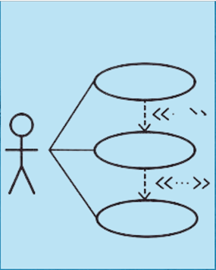
What is Use Case Diagram?
A use case is a set of scenarios that describing an interaction between a user and a system.
A use case diagram displays the relationship among actors and use cases.

Slide 3
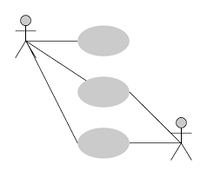
Elements of Use Case Diagram
The two main components/elements of a use case diagram are
Actors
Use cases

Slide 4
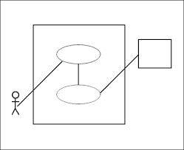
Actor
An actor is represents a user or another system that will interact with the system you are modeling.

Slide 5
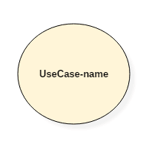
Use Case
A use case is an external view of the system that represents some action the user might perform in order to complete a task.
A use case in a use case diagram is a visual representation of distinct business functionality in a system. The key term here is...Distinct business functionality.

Slide 6
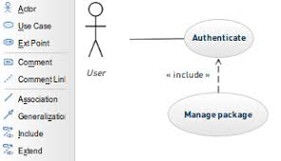
Definition
The Use case diagram is used to Identify the primary elements and processes that form the system.
The primary elements are termed as actors and the processes are called use cases.
The Use case diagram shows which actors interact with each use case.

Slide 7
Example
A user placing an order with a sales company might follow these steps.
I) Browse catalog and select items.
2) Call sales representative.
3) Supply shipping information.
4) Supply payment information.
5) Receive conformation number from salesperson.

Slide 8
Example
ATM System

Slide 9
Quiz
Make a use case diagram for Student Registration System using three actors student, Instructor and Administrator.

Slide 10
Quiz Solution

Slide 11
When to Use, Use Cases Diagrams?
Use cases are used in almost every project. They are helpful in exposing requirements and planning the project.
During the initial stage of a project most use cases should be defined, but as the project continues more might become visible.
Use case diagrams are helpful in three areas.
Determining features (requirements).
Communicating with clients.
Generating test cases.

Slide 12
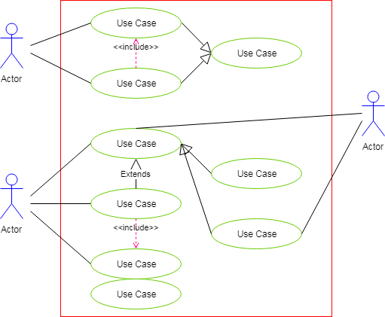
Relationships in Use Cases
A relationship between two use cases is basically a dependency between the two use cases.

Slide 13
Relationships in Use Cases
Communicates: It is used to connect an actor to a use case.
Includes: It describes the situation where a use case contains a behavior that is common to more than one use case
Extends: It describes the situation where one use case possesses the behavior that allows the new use case to handle a variation or exception.
Generalizes: A generalization relationship is also a parent-child relationship between use cases.
The child use case in the generalization relationship has the underlying business process meaning, but is an enhancement of the parent use case.
In a use case diagram, generalization is shown as a directed arrow with a triangle arrowhead
The child use case is connected at the base of the arrow. The tip of the arrow is connected to the parent use case.

Slide 14
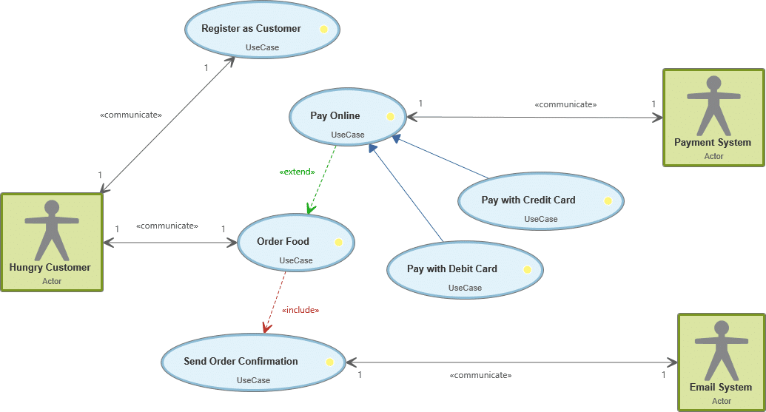

Slide 15
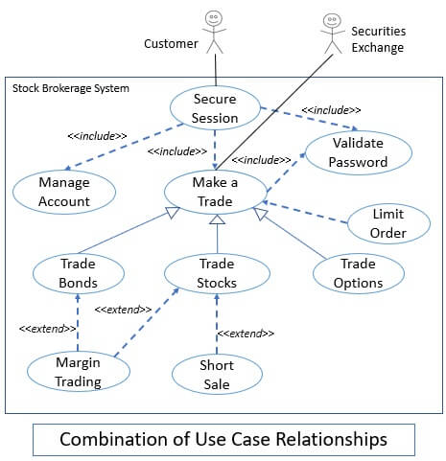

Slide 16
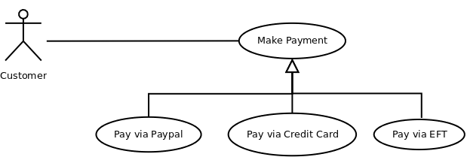
Quiz: Which kind of Relationship exists?

Slide 17
Solution: Which kind of Relationship exists?

Slide 18
Example:
Use Case Diagram for Hospital Management System

Slide 19
Quiz
Make a use case diagram for a travel agency who is responsible for arranging tours of the user in terms of booking the ticket, arranging trip and complete other essentials related t the tour.
Customer is liable to pay amount to the agency for the tickets and arrangement of the trip.
You are required to add use cases and define association among them.

Slide 20
Dos and Don'ts
Use cases should not be used to capture all the details of a system.
The granularity to which you define use cases in a diagram should be enough to keep the use case diagram uncluttered and readable, yet, be complete without missing significant aspects of the required functionality.
You will encounter such decision points of the level of granularity that you need to define when you build any of the UML diagrams.

Slide 21
Developing Use Case Scenarios
The followings are must specified in use case scenarios.
Use case name
Actor(s)
Description
Triggering events
Preconditions
Post conditions
Basic path
Alternative path

Slide 22
Quiz
Write a use scenario of change student information by keeping all necessary parts of scenario documentation.

Slide 23
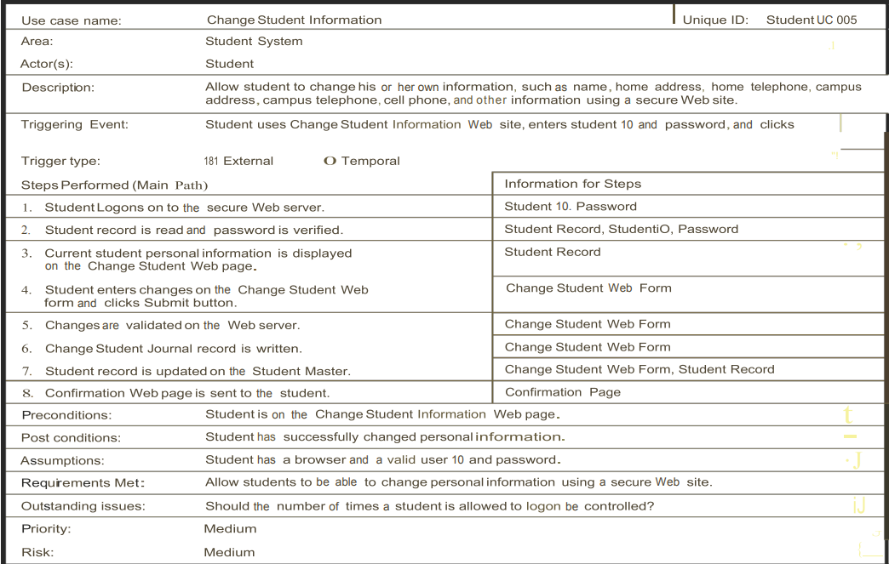
Solution

Slide 24
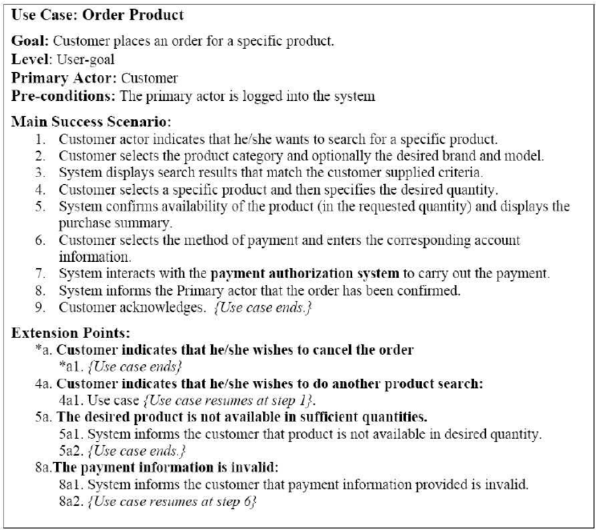

Slide 25
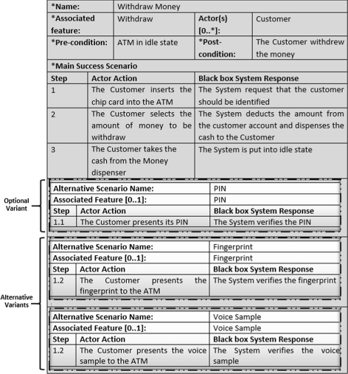

Slide 26
Project:
Use Case Diagram for Library Management System

